Slide 1
Java 4 WEB
Lesson 11 - Home Task Overview

Slide 2
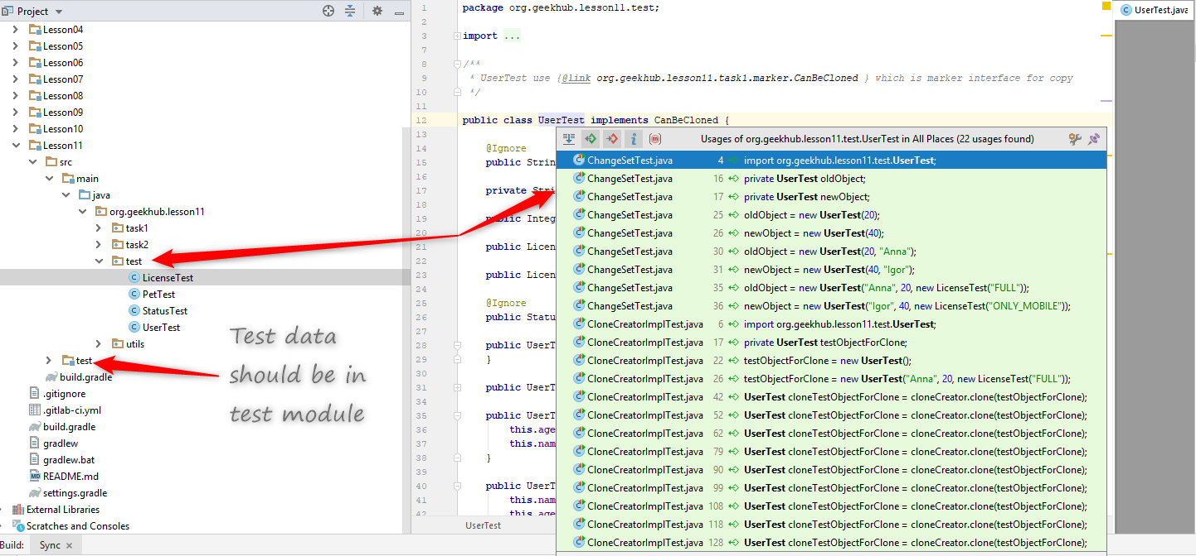
1. Test data should be in test module

Slide 3
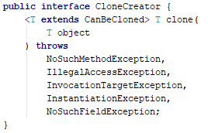
2. Hide implementation details
Notes:
Method should thrown only single CanNotCloneException. It should not make public internal structure.
When the implementation will change, all usages should be updated. Very often usages modification is to painful or even impossible

Slide 4
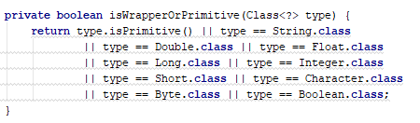
3. Don’t Repeat Yoursel
Notes:
Method name should describe the problem solved but not an implementation details.
`isCloneByValueType` is more appropriate type.

Slide 5
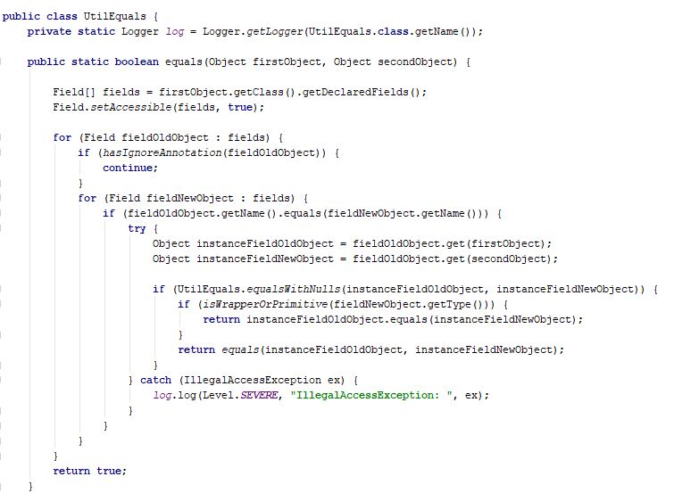
4. Tests should not contain any algorithms
Notes:
Hardcode expected value in tests, do not duplicate (partially or fully) business code

Slide 6
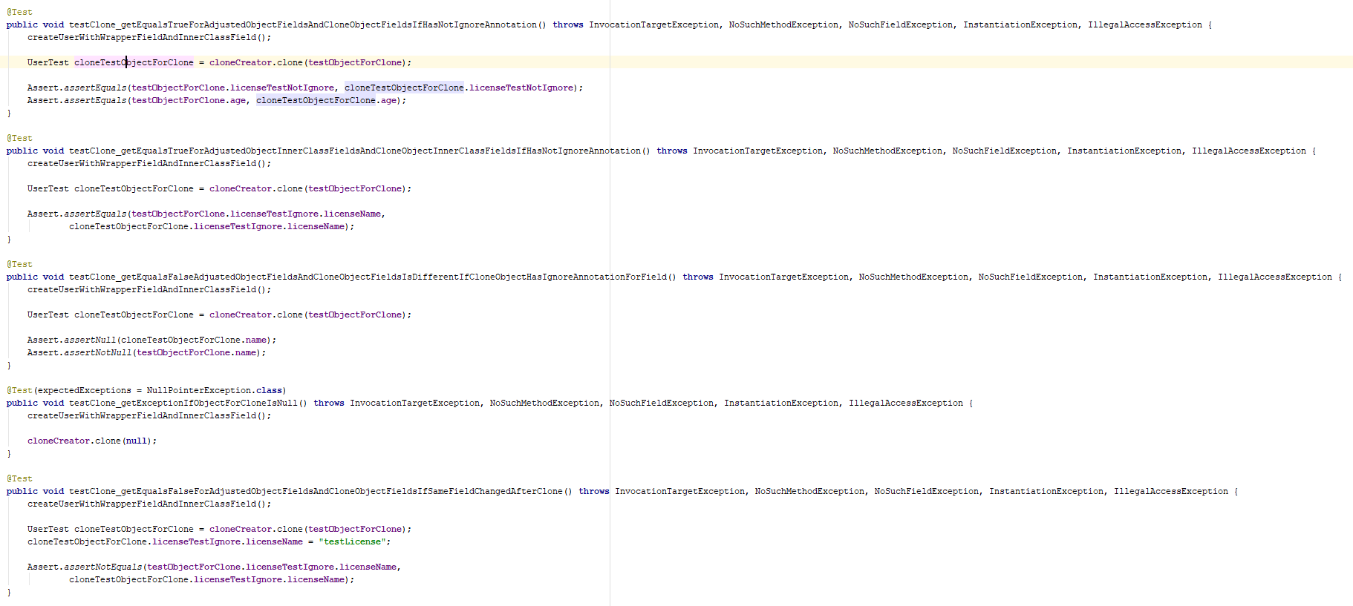
5. When code is ugly think about correctness
Notes:
When your code looks weird and non cool, think maybe the implementation is incorrect/

Slide 7
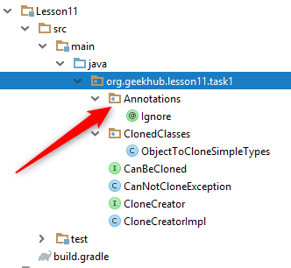

6. Follow naming convention

Slide 8
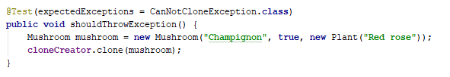
7. Describe tested business rule in test name

Slide 9
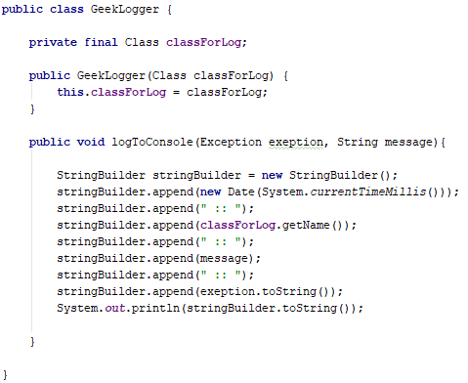
8. Use polymorphism
Notes:
Introduce interface Logger and few implementations like ConsoleLogger, FileLogger…. Describe logger target in class name but not methods. Implementations details should be hidden

Slide 10
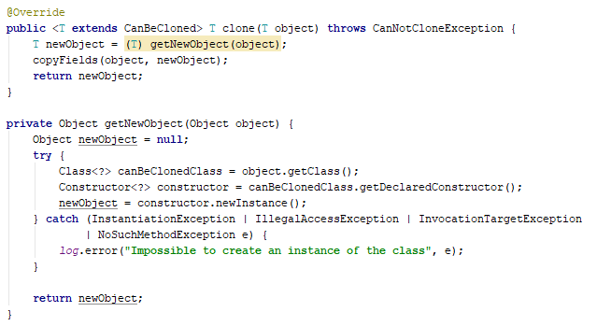
9. Use correct error handling
Notes:
Exception should be thrown instead of null returned

Slide 11
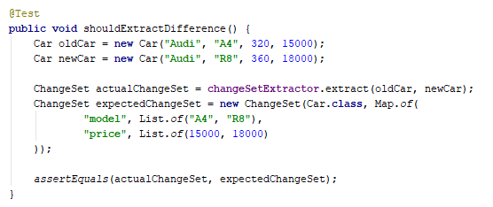
10. Test failure should tell enough info

Slide 12
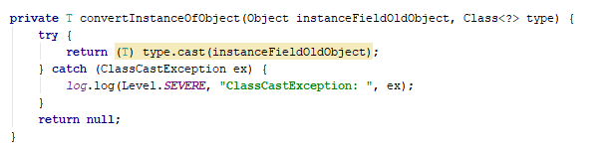
11. Don’t Repeat Yourself
Notes:
Specify failed logic but not exception name in log
Use specific methods for log level specification
Do not return null, because program can not continue correctly extract changeset, throw exception

Slide 13
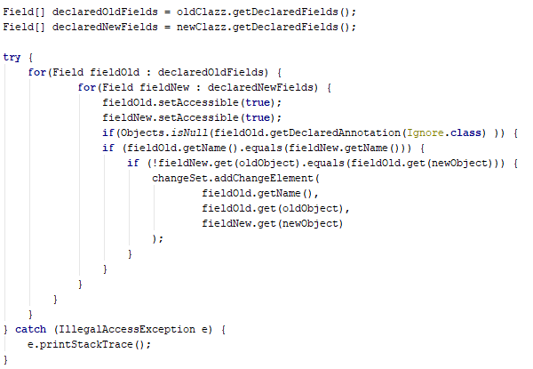
12. Optimize
Notes:
Fields list are same because they are retrieved from objects of same type, so one loop and if are useless
Thrown exception and log message by logger but not stacktrace
Field::isAnnotationPresent is more readable method, instead of null check

